Slide 1


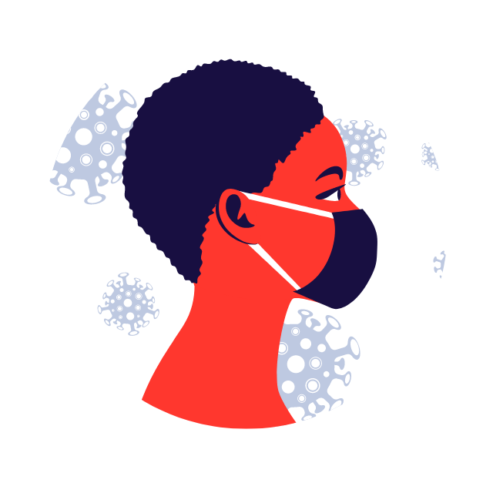
Presentation on
Detecting people who aren’t wearing masks
Under the guidance of
Dr. Pawan Kumar Tiwari
Mr. Abhishek Singh
By
Navin Chandra (1805210027)
Arnab Debnath (1805210011)
Tushar Giri (1805210059)

Slide 2
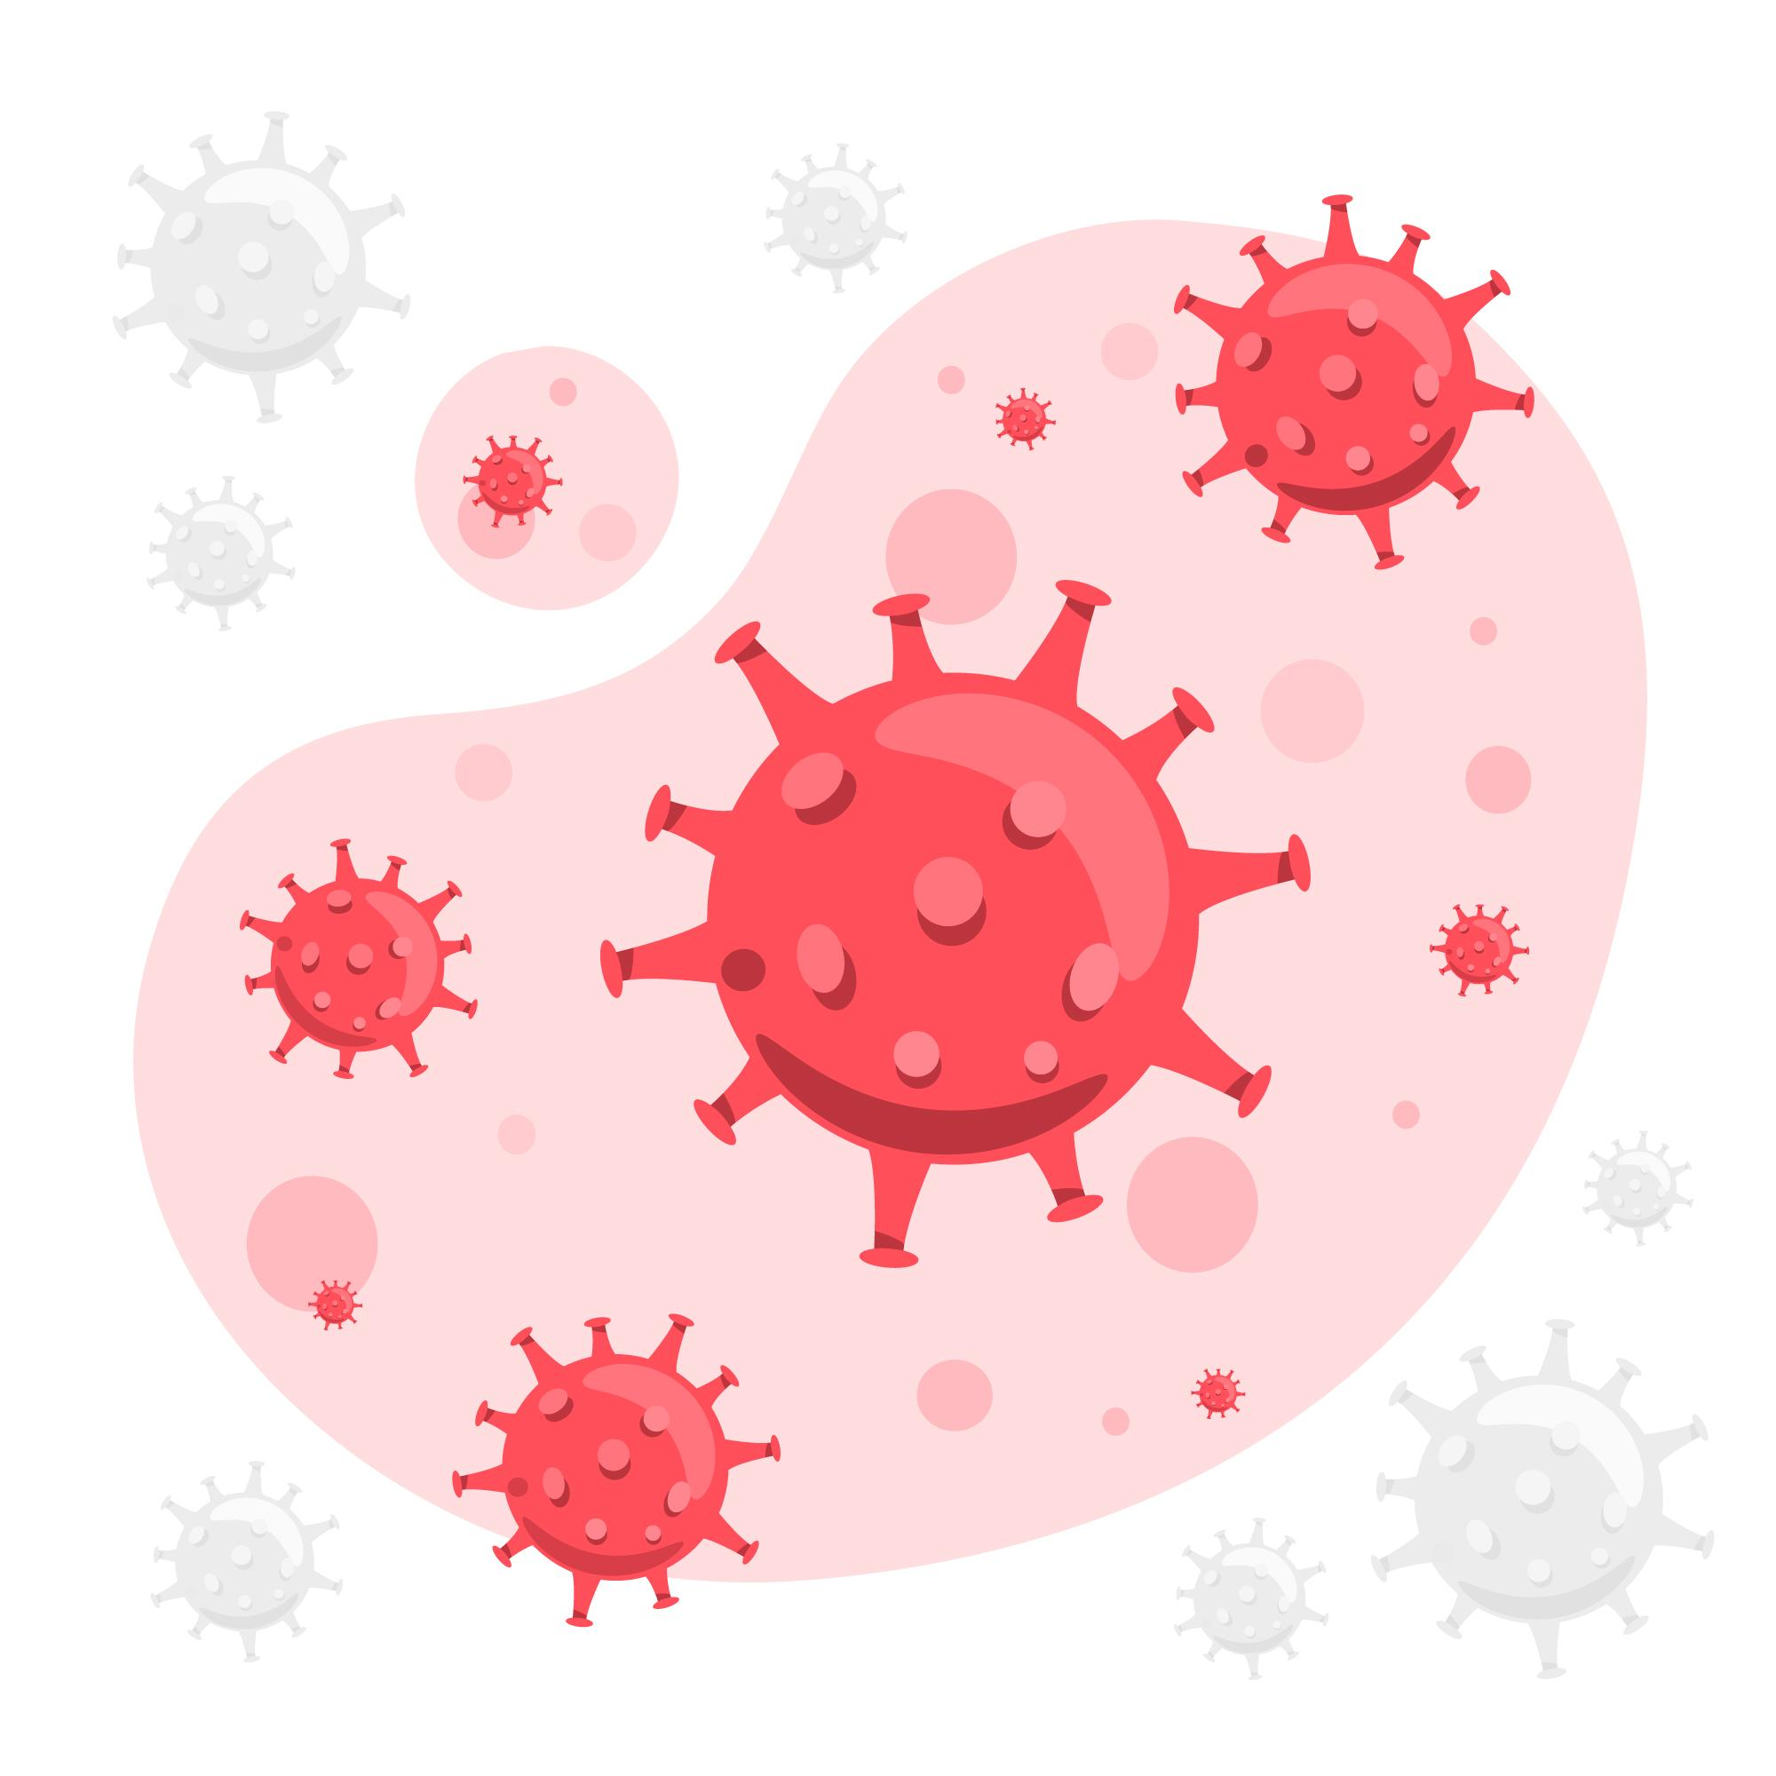
Introduction
It started from Wuhan, China and spreaded throughout the world affecting the world's economy and taking lives of many people.
From then, we are being told that the one of most effective weapon against the COVID virus is Mask and Sanitizers.
So, it is important that people should wear masks when people go out in public.
There have been strict laws in every country, that everyone should wear masks in public places in order to avoid contamination.

Slide 3
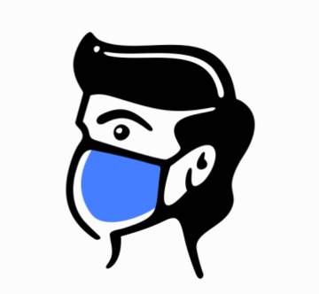
Why we choose this project?
COVID is not over yet, every year new variants are emerging. So, wearing mask will be necessary in future also.
In INDIA, its difficult to keep track if all people moving in public places are wearing masks affectively or not.
Those who are not wearing mask, are they aware of the importance of wearing masks? We can inform them using our model.
Therefore, spotting those people who are not wearing masks is our target to achieve through this model. Also we will be trying to find contacts of those people and aware them either though some message or some fines.

Slide 4
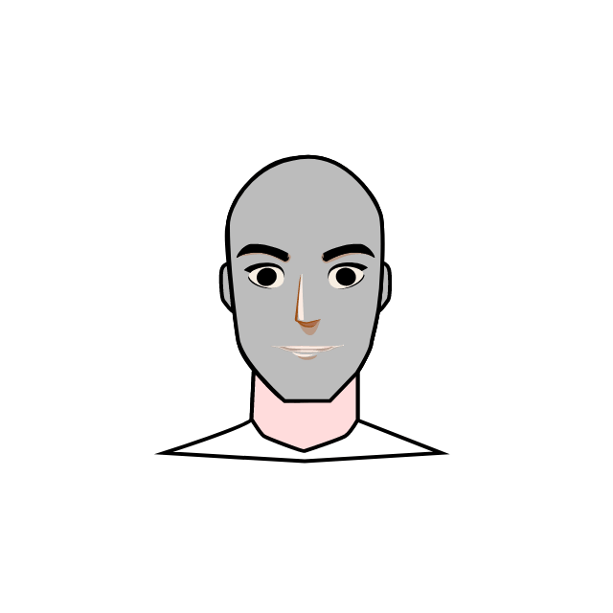


Methodology
We will be using the following technologies to bring this idea to live.
MobileNet V2 (Used for mask detection)
2. Facial Recognition (Used for identification of face)
3. Twilio & SMTP (Used for sending messages)

Slide 5

What is MobileNet V2?
As the name applied, the MobileNet model is designed to be used in mobile applications, and it is TensorFlow first mobile computer vision model.
MobileNetV2 is a method based on Convolutional Neural Network (CNN).
It is developed by Google with improved performance and enhancement to be more efficient
MobileNet size 17 MB and VGG 16 Size 553 MB

Slide 6
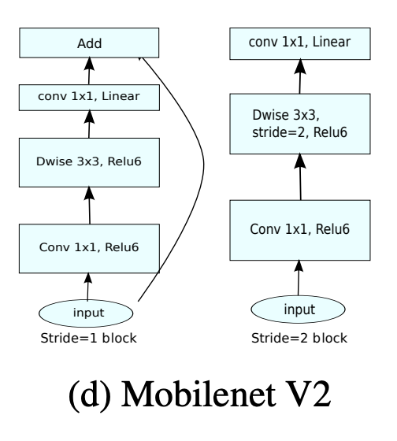
Architecture
MobileNet uses depth wise separable convolutions. It significantly reduces the number of parameters.
A depth wise separable convolution is made from two operations.
Depthwise convolution.
Pointwise convolution.
The main difference between MobileNet architecture and a traditional CNN is, instead of a single 3x3 convolution layer followed by the batch norm and ReLU. Mobile Nets split the convolution into a 3x3 depth-wise conv and a 1x1 pointwise conv, as shown in the figure.

Slide 7
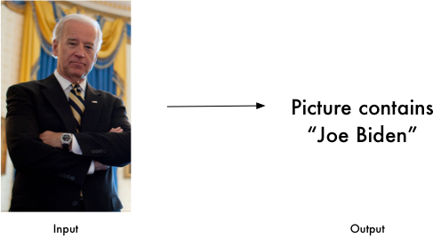
Facial Recognition
Face recognition refers to the technique or method of recognising people's faces from photographs and videos.
On the Labeled Faces in the Wild benchmark, the model achieves a 99.38 percent accuracy rate.
Facial recognition will here help us to identify the people who have not worn mask.

Slide 8
Workflow of facial recognition?
A picture of your face is captured from a photo or video. Your face might appear alone or in a crowd. Your image may show you looking straight ahead or nearly in profile.
Facial recognition software reads the geometry of your face. Key factors include the distance between your eyes and the distance from forehead to chin. The software identifies facial landmarks — one system identifies 68 features of them — that are key to distinguishing your face. The result: your facial signature.
Your facial signature — a mathematical formula — is compared to a database of known faces.
A determination is made. Your faceprint may match that of an image in a facial recognition system database.

Slide 9
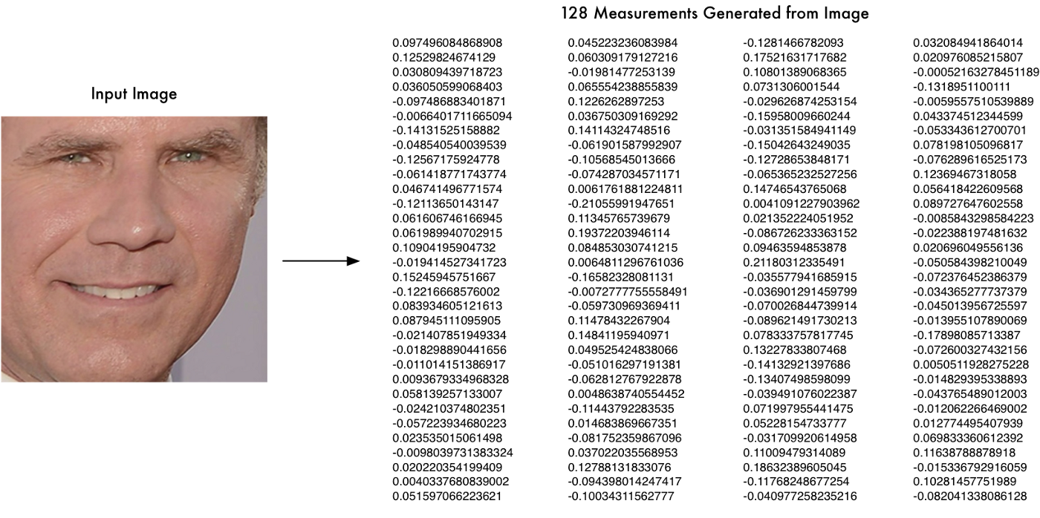

Slide 10


Twilio & SMTP
Twilio is a sms sending API.
SMTP is a protocol for sending the mail.
Twilio & SMTP is very fast and can send messages within seconds.
Twilio is implemented based on microservice architecture.

Slide 11
Implementation
Data Collection: The development of the Face Mask Recognition model begins with collecting the data. At this step, the image is cropped until the only visible object is the face of the object.
Pre-processing: The pre-processing phase is a phase before the training and testing of the data. There are four steps in the preprocessing which are resizing image size, converting the image to the array, pre-processing input using MobileNetV2, and the last is performing hot encoding on labels.
Split the Data: After the preprocessing phase, the data is split into two batches, which are training data namely 80 percent, and the rest is testing data. Each batch is containing both of with-mask and without-mask images.
Building the Model: There are six steps in building the model which are constructing the training image generator for augmentation, the base model with MobileNetV2, adding model parameters, compiling the model, training the model, and the last is saving the model for the future prediction process.
Testing the Model: To make sure the model can predict well, there are steps in testing the model. The first step is making predictions on the testing set.
Data Collecting
Pre-processing
Split the Data
Building the Model
Testing the Model

Slide 12
Implementation
The dataset Link that we used consists of 3833 images belonging to two classes:
with_mask: 1915 images
without_mask: 1918 images
Then we train our model with the help of dataset.
Applying face recognition on loaded image.
If the person has not worn the mask then we recognize the face of that person using the face recognition library.
Find the details of that person from database and will send a notification on email or contact number associated with that image(face).

Slide 13
Implementation
PHASE 1
Train face mask detector
Load face mask dataset
Pre-processing the dataset
Splitting the dataset & train for future prediction
PHASE 3
Sending messages for warning
Triggers to send messages
For email, SMTP library is used in python
PHASE 2
API call
Identify people not wearing masks
Photo is captured for identification
Reads geometry of face
Detects facial signature of face & compares with database images

Slide 14
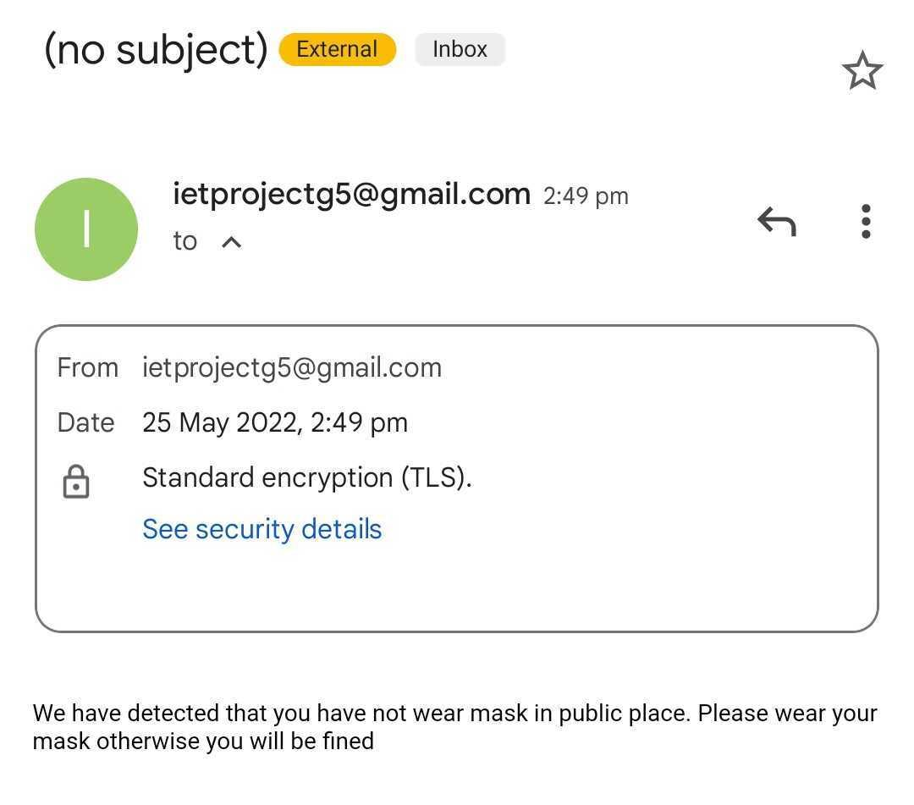
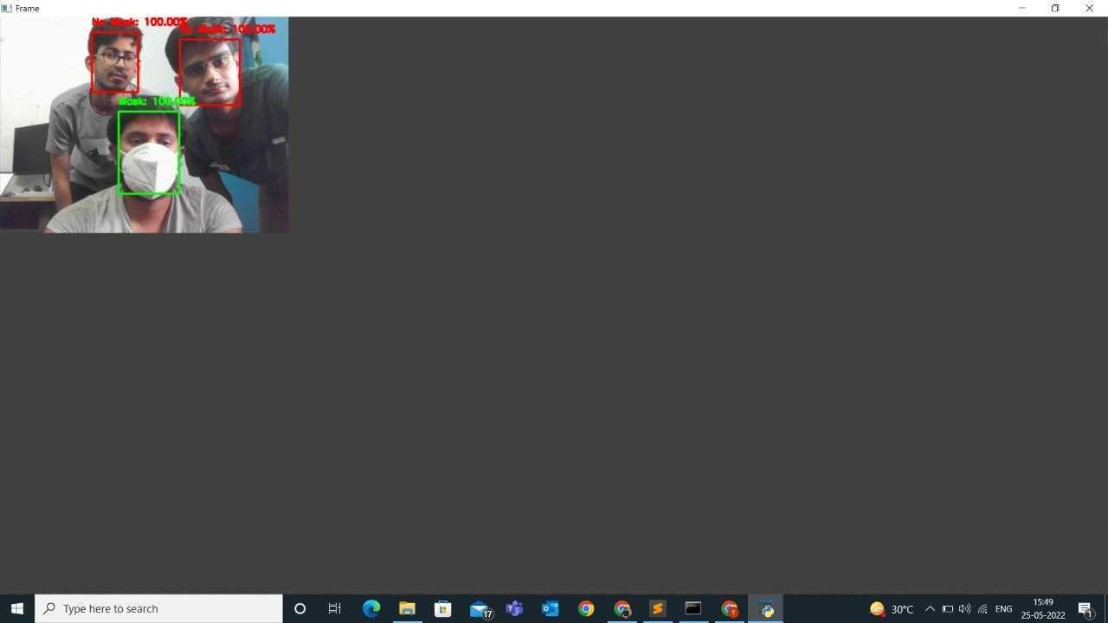
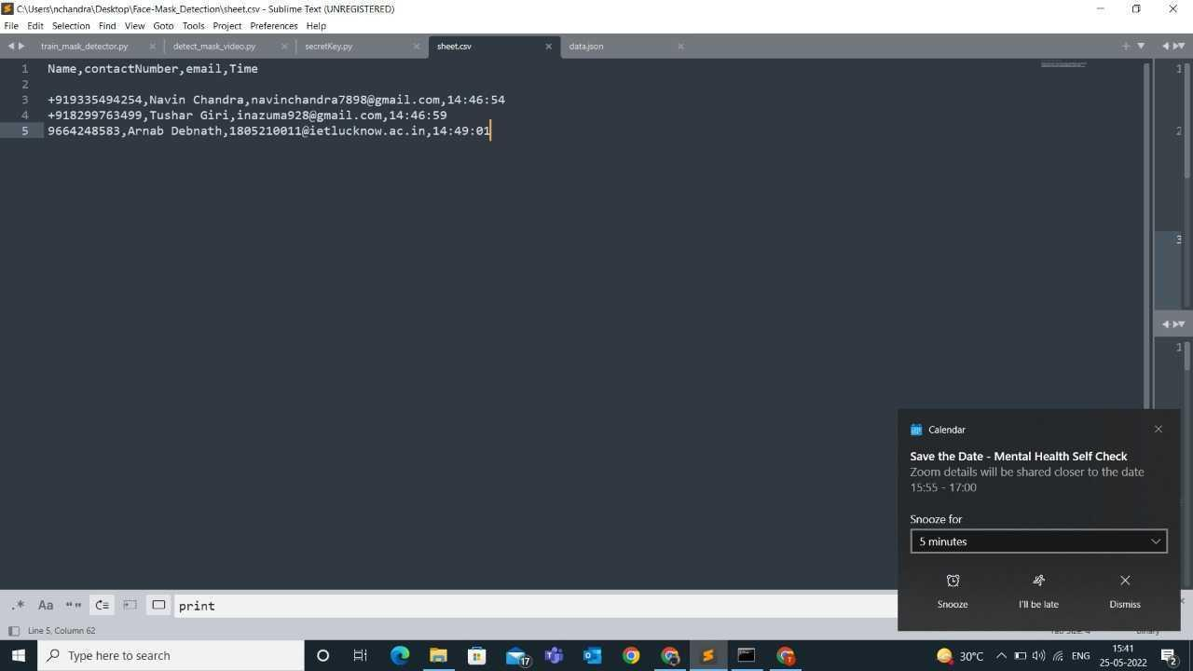
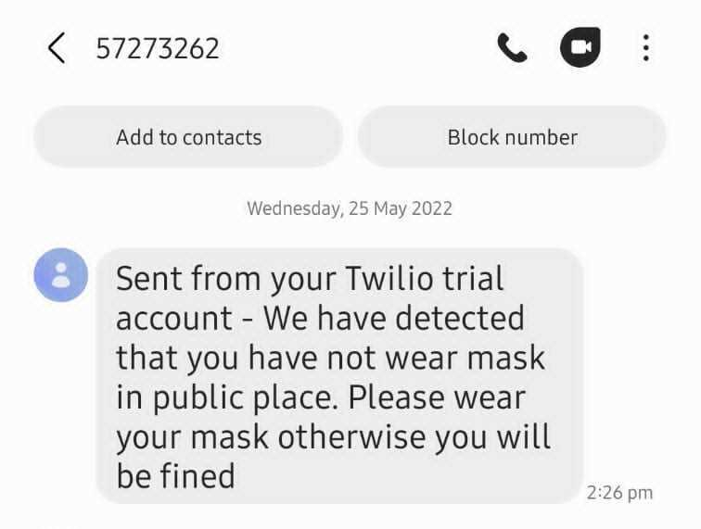
Experimental Results
Detecting people who are wearing masks and who are not wearing mask.
Identifying people not wearing mask by facial recognition
Sending Messages and EMAILS to the desired person.
Email
Message

Slide 15
Application
Detecting people not wearing masks at mall and charge fine from them.
Awaring people through our model, who are not wearing masks in crowded areas.
Employees not following covid norms at office premises.
Students and officials not following covid norms in college premises.

Slide 16
References
[1] The Face Mask Detection For Preventing the Spread of COVID-19 at Politeknik Negeri Batam.
[2] Real-Time Implementation of AI-Based Face Mask Detection and Social Distancing Measuring System for COVID-19 Prevention.
[3] Salama AbdEL monaam D, Almansoori AM, Taha M, Badr E (2020) A deep facial recognition system using computational intelligent algorithms. PLoS ONE 15(12): e0242269. https://doi.org/10.1371/journal.pone.0242269.
[4] MobileNetV2: Inverted Residuals and linear Bottlenecks by Mark Sandler, Andrew Howard, Menglong Zhu, Andrey Zhmoginow and Liang-Chieh Chen 21 March 2019.

Slide 17


